Slide 1
Electronic Mail Security

Slide 2
2 schemes are mainly used to provide security for e-mail
They are
1.pretty good privacy(PGP)
2.S/MIME

Slide 3
Pretty Good Privacy
It provides confidentiality and authentication for e-mail and storage applns
Operations of PGP consists of 5 services
1.Authentication
2.Confidentiality
3.Compression
4.e-mail compatibility
5.Segmentation

Slide 4
1.Authentication
Steps are
1.Sender creates a msg
2.SHA-1 is used to generate a 160bit hash code of the msg
3.Hash code is encrypted with RSA using senders private key and the result is pre-pended to the msg
4.Receiver uses RSA with senders public key to decrypt and recover the hash code
5.Receiver generates a new hash code for the msg and compares it. If the 2 match , msg is accepted as authentic

Slide 5
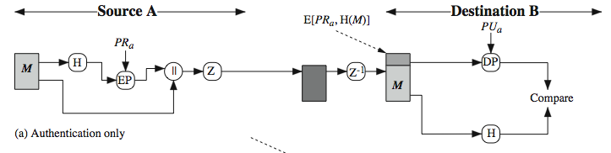
Combination of SHA-1 and RSA provides digital signature

Slide 6
2.Confidentiality
1.Sender generates a msg and a random 128bit no: to be used as a session key for this msg only
2.Msg is encrypted using CAST-128 with session key
3.Session key is encrypted with RSA using recipients public key and is pre-pended to the msg
4.Receiver uses RSA with its private key to decrypt and recover the session key
5.Session key is used to decrypt the msg
CAST-128 is a conventional or symmetric key algm which is faster than an RSA algm

Slide 7
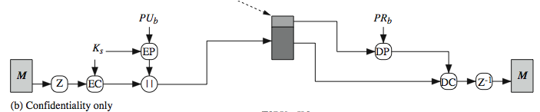

Slide 8
3.Compression
PGP compresses the msg after applying the signature but before encryption
Thus it save space for both e-mail transmission and file storage
Z denotes compression algm and Z⁻¹ denotes decompression
Signature is generated before compression for 2 reasons:
1.It is preferable to sign an uncompressed msg because one can store only uncompressed msg with the signature for future verification
2.If we are applying hash fun and digit signature after compression, it would constrain all PGP implementations to the same version of the compression algm ie we can decompress the msg by using any versions of algm

Slide 9
Msg encryption is only applied after compression to strengthen the cryptographic security. Because the compressed msg has less redundancy than the original msg
Commonly used compression algm is ZIP

Slide 10
4.E-mail Compatibility
When PGP is used a part or all of the resulting block after encryption consists of a stream of arbitrary 8 bit octets
But many e-mail systems only permit the use of blocks consisting of ASCII text
So PGP provides a service of converting the 8bit binary stream to printable ASCII characters
The scheme used for this purpose is radix-64 conversion
Here, each group of 3 octets of binary data is mapped into 4 ASCII characters
This scheme also uses CRC to detect transmission errors
Radix-64 algm converts the i/p stream to radix 64 format even if the i/p msg is an ASII text

Slide 11
5.Segmentation and Reassembly
E-mail facilities restricted to a max msg length
Any msg longer than that must be broken into smaller segments each of which is mailed separately
PGP automatically subdivides a msg that is too large, into segments that are small enough to send through e-mail
Segmentation is done only after all other processing including radix-64 conversion
At the receiving end , PGP strip off all e-mail headers and reassemble the original block

Slide 12
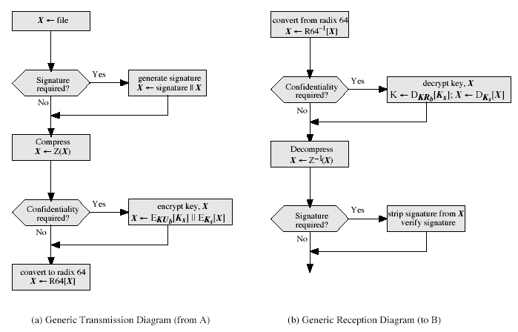

Slide 13
Cryptographic Keys and Key Rings
PGP makes use of 4 types of keys
1.One –time session conventional keys
2.Public keys
3.Private Keys
4.Passphrase based conventional keys

Slide 14
Session Key Generation
Each session key is associated with a single msg and is used for encryption/decryption
Encryption/Decryption is done with the symmetric key algm
Key Identifiers
An encrypted msg is send with an encrypted form of session key
Session key is encrypted with the receivers public key
Hence only receiver will be able to recover the session key and recover the msg

Slide 15
If a single public/private key pair is used ,then the receiver can automatically decrypt the session key
But if multiple key pairs are used then the receiver don’t know which of its public keys was used to encrypt the session key
One solution is to transmit the public key with the msg so that the receiver can know about the public key
An RSA public key may be 100’s of decimal digits in length, so there occur a pblm when it appends to the msg

Slide 16
Inorder to avoid this ,we associate an identifier with each public key that is unique for each user
Ie User ID+Key ID would be sufficient to identify a key
So a shorter key ID would be transmitted along the msg
Key identifier uses the 64 least significant bit of the public key

Slide 17
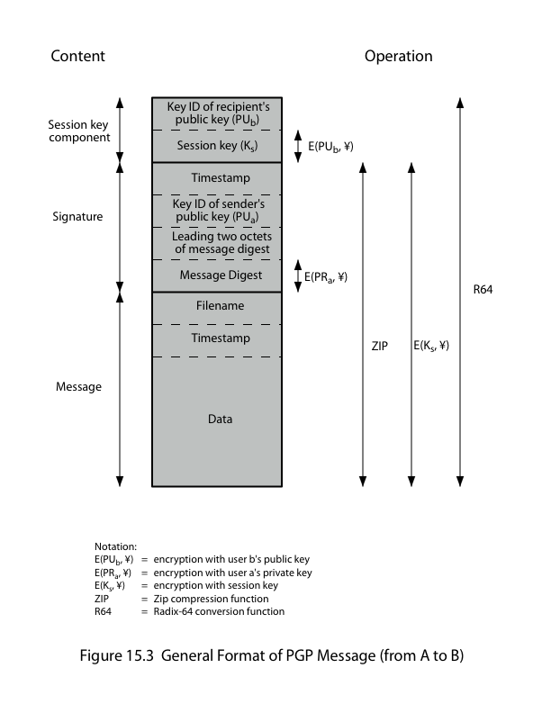
PGP MSG FORMAT

Slide 18
EPUb-encryption with user b’s public key
EPRa-Encryption with user a’s private key
Eks-Encryption with session key
ZIP-Zip compression fun
R64-Radix 64 conversion fun

Slide 19
PGP msg has 3 components
1.Msg Component
Consist of original data , file name and timestamp specifies the time of creation
2.Signature Component
It is optional
Timestamp-Specifies the time
Key ID of Kua-To identify the public key
Leading 2 octets of msg digest-To enable the receiver to check if the correct public key was used to decrypt the msg by comparing the plaintext copy of 1st 2 octets with first octets of decrypted digest
Msg Digest-It is a 160 bit SHA-1 digest encrypted with senders private signature key

Slide 20
3.Session Key Component
Includes session key and identifier of the recipients public key that was used by the sender to encrypt the session key
Msg component + signature component may be compressed using ZIP and may be encrypted using a session key
The entire block is usually encoded with radix-64 encoding

Slide 21
Key Rings
A pair of data structures is provided at each node
One to store the public/private key pairs owned by that node and one to store the public keys of other users known at this node
These data structures are referred to as the private key ring and public key ring
Private key ring can be indexed by either user ID or key ID

Slide 22
PGP Key Management
rather than relying on certificate authorities
in PGP every user is own CA
can sign keys for users they know directly
forms a “web of trust”
trust keys have signed
can trust keys others have signed if have a chain of signatures to them
key ring includes trust indicators
users can also revoke their keys

Slide 23
S/MIME
Secure/Multipurpose internet mail extensions
It is a security enhancement to the MIME internet email format standard , based on technology from RSA data security and defined in RFC’s
S/MIME will emerge as the industrial standard for commercial and organizational use while PGP is a choice for personal email security for many users

Slide 24
S/MIME is similar to PGP
Both offers the ability to sign or encrypt msgs

Slide 25
S/MIME Functionality
1.Enveloped Data
Consists of encrypted content of any type and encrypted content encryption keys for one or more recipients
2.Signed Data
Msg digest of the msg to be signed+ Content and signature encoded using base64
Signed data can be only viewed by the receiver that has the S/MIME capability
3.Clear Signed Data
As with signed data , a digital signature is formed
Here only digital signature is encoded using base64

Slide 26
Signed and enveloped data
Signed only and encrypted only entities may be nested, so that encrypted data may be signed and signed data or clear signed data may be encrypted

Slide 27
Cryptographic Algorithms
Diff cryptographic algms used in S/MIME are
1.Digital signature standard algm(DSS) for providing digital sig to the msg
2.Diffie Hellman algm for encrypting session keys
3RSA can be used for both signatures and session key encryption
4.SHA-1 is used to generate a 160bit hash code which can be prepended to the msg
5.Three key triple DES algm is also used for msg encryption

Slide 28
S/MIME msgs
It makes use of a no: of new MIME content types
All new appln use the designation PKCS-This refers to a set of public key cryptographic specifications by RSA
Securing a MIME Entity
S/MIME secures a MIME entity with a signature,encryption or both
A MIME entity may be an entire msg or if the content type is ‘multipart’ then it is one or more of the subparts of the msg

Slide 29
MIME entity+security related data such as algm identifiers and certificates are processed by S/MIME to produce a PKCS obj
PKCS obj is now treated as msg content and wrapped in MIME
Enveloped Data
Steps for preparing an enveloped data MIME entity are:
1.Generate a pseudorandom session key
2.Encrypt the session key with receivers public RSA key
3For each receiver , prepare a block known as Recipient info that contain senders public key certificate+algm identifier + encrypted session key
4.Encrypt the msg content with the session key

Slide 30
Signed Data
Steps are
1.Select a msg digest algm(SHA or MDS)
2.Compute msg digest or hash fun of the content to be signed
3.Encrypt the msg digest with signers private key
4.Prepare a block known as signal info that contains signers public keycertificate+algm identifier+algm identifier to encrypt+encrypted msg digest

Slide 31
Clear Signing
It is achieved using the multipart content with a signed type
Multipart /signed msg has two parts
1.Any MIME type,but must be prepared so that it will not be altered during transfer from source to destination
2.MIME content type of appln and subtype of PKCS-7 signature

Slide 32
S/MIME certificate processing
S/MIME uses public key certificate of version3 of X.509
As with PGP,S/MIME managers must configure each client with a list of trusted keys and with certificate revocation lists
Certificates are signed by certification authority
S/MIME user has several mgmt functions
1.Key generation
2.Registration-users public key must be registered with a CA to receive an X.509 public key certificate
3.Certificate Storage-To verify incoming signatures and to encrypt outgoing msgs

Slide 33
VeriSign Certificates
Most widely used is the VeriSign CA services
This service is compatible with S/MIME
It issues certificate with the product name Verisign digital ID
Each digital ID contains the following
Owners public key
Expiration date of digital ID
Serial no: of digital ID
Name of CA that issued the digital IS
Digital signature of CA that issued the digital ID

Slide 34
It also contains other infor such as
Address
Email address
Basic registration information

